Slide 1
SPM THROUGH SIMULATION
NIMRA JABEEN
BSCS-F19-M88

Slide 2
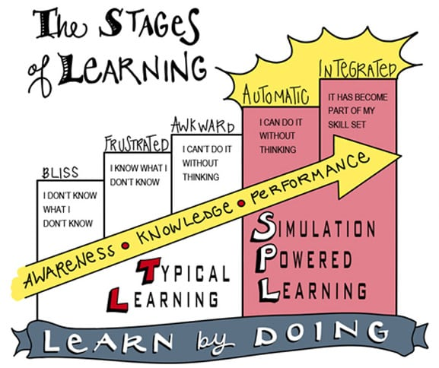
Introduction
Simulation is the re-presentation of real-life system by another system
computer simulation, the use of a computer to represent the dynamic responses of one system by the behaviour of another system modeled after it.
Limitation of operation
Real-world process.

Slide 3
background
Name | Year | Problem | Method | conclusion
Cymer Inc | 2015 | Manufacturing cost increases | SIMULATOR | Simulation is extensively being used as a tool to increase production capacity
John mcleod | 2018 | Course subject | Learning, teaching | Experienced and skilled workers
Da yang | 2016 | Greater energy consumption | DeST | Integrated building simulation
Barbara sittner | 2017 | Designing issues | NLN framework | Designing ,implementation tools
Dr Addish | 2016 | Validation | Episodic simulation | Age-related changes in episodic simulation

Slide 4
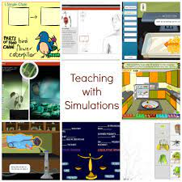
methodology
simulation-based education is the pedagogical approach of providing students with the opportunity to practice learned skills in real-life situations.
Educational simulation is a teaching method that tests participants' knowledge and skill levels by placing them in scenarios where they must actively solve problems.

Slide 5
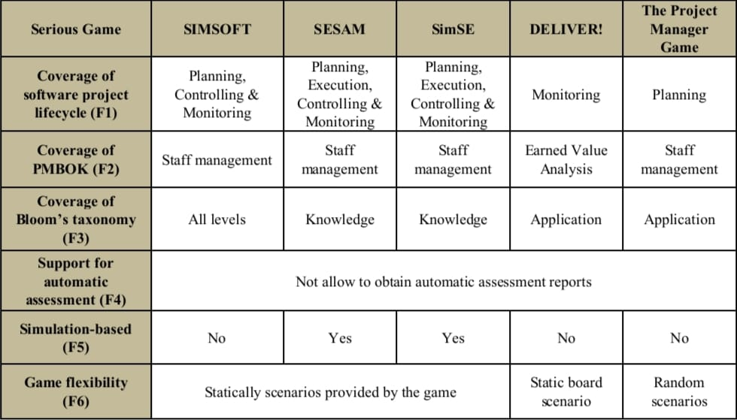
discussion

Slide 6
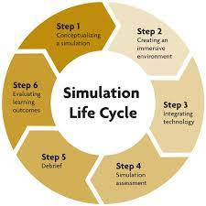
conclusion
ProDec, a simulation-based serious game for
software project management, which aims to teach,
assess and motivate learners in learning and
practicing the principles of software project
management and improve their skills.

Slide 7
Thankyou

